Slide 1
Professional Practices
Software Team Development

Slide 2

Introduction
Stages of Team development.
Barriers to Team Building.
Characteristics of High Performance Teams.
How to manage conflicts.

Slide 3
Introduction
What is a team?
A team can be defined as a group of individuals coming together to solve a problem.
Why we need a team?
When one person cannot accomplish a job alone and several individuals must cooperate to fulfill a mission or task.

Slide 4
Introduction
What is Team Management?
Team management is the ability of an individual or an organization to administrate and coordinate a group of individuals to perform a task.
The administration of a group of people assembled to work on a particular project or to perform a particular function within an organization.
Team management involves teamwork, communication, objective setting and performance etc.
Team management is the capability to identify problems and resolve conflicts within a team.

Slide 5
Stages of Team Development
5 Stages of Team Development
Forming
Storming
Norming
Performing
Adjourning (Added by Tuckman in 1977).

Slide 6
Stages of Team Development

Slide 7
Stages of Team Development
Forming:
This is where team members first meet. It’s important for team leaders to facilitate the introductions and highlight each person’s skills and background. Team members are also given project details and the opportunity to organize their responsibilities.
Why are we here?
What are we doing?
What is our goal, our purpose?

Slide 8
Stages of Team Development
Storming:
Once established - period of struggle for positions and roles within the group.
Some seek out and compete for status, control, authority and influence.
▪ Inner conflict. A period of "testing-out" the leaders.
▪ Disagreements and arguments arise, are felled and manufactured.
In the end, roles are eventually allocated.
The initial leaders may not survive this period: it is the most uncomfortable phase of the group's life.

Slide 9
Stages of Team Development
Norming
Here the team starts to determine roles and responsibilities, sets and agrees on goals, develops operating guidelines for team functioning in their meetings and daily tasks, and determines the level of individual commitment needed to achieve the goals of the team.
Key tasks at this stage are:
to establish the tasks and roles of team members;
to establish the mechanisms of communication; and
to determine leadership and decision-making process.

Slide 10
Stages of Team Development
Performing.
Once teams have reached this level, they are well-equipped machines. The key task at this stage is to maintain effective mechanisms for
continued communication,
conflict resolution,
continued goal and role re-evaluation,
evaluation of outcomes of team functioning, and
making the appropriate adjustments to the team

Slide 11
Stages of Team Development
Adjourning — Success! You made it
This is the time for your team to finally step back to see what they’ve accomplished. Two things happen at this point:
Teams review the last few weeks or months to celebrate their successes.
Teams take an honest look at what didn’t go well and pinpoint where there’s room for improvement.
At the end of the project, set up an online meeting where team members come together to discuss the entire project, from the successes to the frustrations. Ask them to prepare examples beforehand outlining what worked and what didn’t, and then give each person five minutes to share their thoughts. Document the comments so that it’s easy to see which trends emerge and what changes need to be made going forward.

Slide 12
Barriers to Effective Team Building
A lack of team purpose and tasks.
“The only point of having a team is to get a job done, a task completed, a set of objectives met. Moreover, the tasks that teams perform should be tasks that are best performed by a team” (West, 2008, p. 308).

Slide 13
Barriers to Effective Team Building
A lack of freedom and responsibility. Creating a team and failing to give them the freedom and authority to act is like teaching a person to ride a bicycle, giving them a bike, but then telling them they can ride only in the house (West, 2008).
3. Too many members or the wrong members. “Teams should be as small as possible to get the job done and no larger than about 6 to 8 people” (West, 2008, p. 308). It’s also crucial that “teams have the members with the skills they need to get the job done” (West, 2008, p. 308).

Slide 14
Barriers to Effective Team Building
4. An individual-focused organization. “Teams are set up in many places in the organization but all of the systems are geared towards managing individuals. . .Creating team-based organizations means radically altering the structure, the support systems, and the culture” (West, 2008, p. 309).
5. Team processes are neglected rather than developed. Teams need to have clear objectives, meet regularly, participate in constructive debate about how to best serve client needs, share information with one another, coordinate their work, support each other, and review their performance and think about ways to improve it (West, 2008).

Slide 15
Barriers to Effective Team Building
6. Directive instead of facilitative leaders. Leading a team is different from supervising one. Supervisors are directive and advice-giving. A leader of a team, instead, is facilitative and seeking. This leader’s role is “to ensure that the team profits optimally from its shared knowledge, experience, and skill” (West, 2008, p. 309).
7. Conflict with other teams. Ironically, the more cohesive and effective a team becomes, the more competitive and partisan they tend to be in their relationships with other teams throughout an organization. Therefore, it’s important to ensure that interteam cooperation is established and reinforced (West, 2008).

Slide 16
Characteristics of High Performance Teams
A high-performing team is unlike any regular team. It is comprised of highly talented and motivated individuals with common goals. Such team helps their company achieve excellence and growth.
However, each person has a different set of principles and beliefs which could probably taint the team harmony. While it is true, thorough planning and execution of business strategies would help overlook the differences.
According to Dr Tim Baker, there are at least 8 characteristics of high-performing leadership and team development.

Slide 17
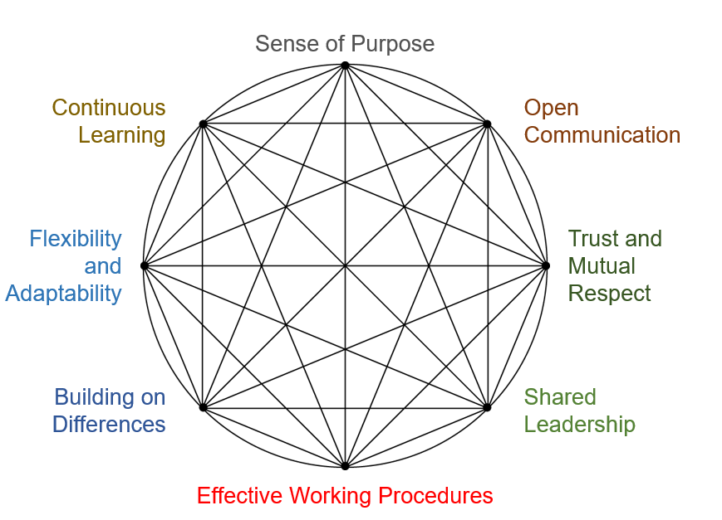
Characteristics of High Performance Teams
Here is the model of a high-performing team

Slide 18
Characteristics of High Performance Teams
Sense of Purpose
Individuals with a sense of purpose have clearly defined their mission and goals since the beginning. These people have set their eyes on the priorities and are driven with a strong focus on results and solution.
Open Communication
One of the most important characteristics of a high-performing team is open communication. Members who are not afraid to express their ideas and thoughts, as well as listen to what others have to say, are indeed professionals.

Slide 19
Characteristics of High Performance Teams
Trust and Mutual Respect
Respect and trust are two words that correlate with each other. In a professional setting, a leader and its followers do exist. As part of a team, both should learn how to trust and respect each other.
Shared Leadership
An effective leader asks for ideas and suggestions from their members. They value their team’s insights and are not autocratic. This kind of leaders understands the key role of their members.

Slide 20
Characteristics of High Performance Teams
Effective Working Procedures
Aside from being highly skilled, effective team leaders are also resourceful. They don’t stop at “good” but rather aim for the “best”, every chance they get. They encourage creativity and find the most outstanding way to achieve their goal.
Building on Differences
Efficient leaders don’t look at differences as drawbacks of an individual. Instead, they use it as a weapon to create alternatives and other approaches that may be useful in different situations.

Slide 21
Characteristics of High Performance Teams
Flexibility and Adaptability
A high-performing team consists of adaptable and agile individuals. Variables like a fast-paced working environment don’t scare these kinds of people for they can easily adjust to any given situation.
Continuous Learning
The hunger for discoveries and newly acquired knowledge is the last characteristic of a high-performing team. Their desire to learn everything that they can or what might help improve their craft is an essential matter.
People with characteristics as listed above are such great assets to the company. Not only can they guarantee an increase in sales, but also boosts employee morale.

Slide 22
Team Conflict Resolution
1. Talk with the other person.
Ask the other person to name a time when it would be convenient to meet.
Arrange to meet in a place where you won't be interrupted.
2. Focus on behavior and events, not on personalities.
Say “When this happens …” instead of “When you do …”
Describe a specific instance or event instead of generalizing.

Slide 23
Team Conflict Resolution
3. Listen carefully.
Listen to what the other person is saying instead of getting ready to react.
Avoid interrupting the other person.
After the other person finishes speaking, rephrase what was said to make sure you understand it.
Ask questions to clarify your understanding.
4. Identify points of agreement and disagreement.
Summarize the areas of agreement and disagreement.
Ask the other person if he or she agrees with your assessment.
Modify your assessment until both of you agree on the areas of conflict.

Slide 24
Team Conflict Resolution
5. Prioritize the areas of conflict.
Discuss which areas of conflict are most important to each of you to resolve.
6. Develop a plan to work on each conflict.
Start with the most important conflict.
Focus on the future.
Set up future meeting times to continue your discussions.

Slide 25
Team Conflict Resolution
7. Follow through on your plan.
Stick with the discussions until you have worked through each area of conflict.
Maintain a collaborative, “let’s-work-out-a-solution” attitude.
8. Build on your success.
Look for opportunities to point out progress.
Compliment the other person’s insights and achievements.
Congratulate each other when you make progress, even if it’s just a small step. Your hard work will pay off when scheduled discussions eventually give way to ongoing, friendly communication.

Slide 26
References
Donnellon, A. (2006). Leading teams: Pocket mentor. Boston, MA: Harvard Business School Publishing.
Nguyen, S. (2010, December 17). Eight Common Problems Teams Encounter. Retrieved from https://workplacepsychology.net/2010/12/17/eight-common-problems-teams-encounter/
Spector, P. E. (2012). Industrial and organizational psychology: Research and practice (6th ed.). Hoboken, NJ: John Wiley and Sons.
Unsworth, K. L. & West, M. A. (2000). Teams: The challenges of cooperative work. In N. Chmiel (Ed.), An introduction to work and organizational psychology: A European perspective (pp. 327-346). Oxford, UK: Blackwell Publishing.
West, M. A. (2008). Effective teams in organizations. In N. Chmiel (Ed.), An introduction to work and organizational psychology: A European perspective (2nd ed; pp. 305-328). Oxford, UK: Blackwell Publishing.

Slide 27
Assignment
A team has been pulled together from various parts of a large service organization to work on a new process improvement project that is needed to improve how the company manages and supports its client base. The team lead on this project is Sandra from the Chicago office who has 15 years experience as a project manager/team lead managing process improvement projects.
The other members of the team include:
Peter: 10 years experience on various types of projects, expertise in scheduling and budget control (office location: San Diego)
Sarah: 5 years experience as an individual contributor on projects, strong programming background, some experience developing databases (office location: Chicago)
Mohammed: 8 years experience working on various projects, expertise in earned value management, stakeholder analysis and problem solving (office location: New York)
Donna: 2 years experience as an individual contributor on projects (office location: New York)
Ameya: 7 years experience on process improvement projects, background in developing databases, expertise in earned value management (office location: San Diego)
Sandra has worked on projects with Sarah and Mohammed, but has never worked with the others. Donna has worked with Mohammed. No one else has worked with other members of this team. Sandra has been given a very tight deadline to get this project completed.
Sandra has decided that it would be best if the team met face-to-face initially, even though they will be working virtually for the project. She has arranged a meeting at the New York office (company headquarters) for the entire team. They will spend 2 days getting introduced to each other and learning about the project.
Support your answer in the light of Team Development and how you make the performance increase of your team ?

